Slide 1
Automated Vehicle Parking System
Everyone who owns or drives a vehicle in India or abroad, would be all too familiar with the hassles of finding parking spaces, misbehaving parking attendants, inconsistent or monopolized rates and other problems associated with it.
The Automated Vehicle Parking System had been conceived with the view to automate the manual workflows involved in the management of Vehicle
Parking Lots.

Slide 2
HOW They work
Automated car parking systems use a similar type of technology to that used for mechanical parcel handling and document retrieval. The driver leaves the car inside an entrance area and technology parks the vehicle at a designated area. Hydraulic or mechanical car lifters raise the vehicle to another level for proper storing. The vehicle can be transported vertically (up or down) and horizontally (left and right) to a vacant parking space until the car is needed again. When the vehicle is needed, the process is reversed and the car lifts transport the vehicle back to the same area where the driver left it. In some cases, a turntable may be used to position the car so that the driver can conveniently drive away without the need to back up.

Slide 3

Software/hardware requirements
Network Interface card
Monitor
Keyboard
Mouse
Printer
SOFTWARE REQUIRMENTS
Operating System
Java 2 Platform Standard Edition v1.4.2 or higher
Oracle DB or MySql

Slide 4
AUTOMATED PARKING BENIFITS
There are several advantages of employing a car park system for Urban planners, business owners and vehicle drivers. They offer convenience for vehicle users and efficient usage of space for urban-based companies. Automated car park systems save time, money, space and simplify the often tedious task of parking. Auto car lifts move vehicles into safe and secure storage areas until they are needed.

Slide 5
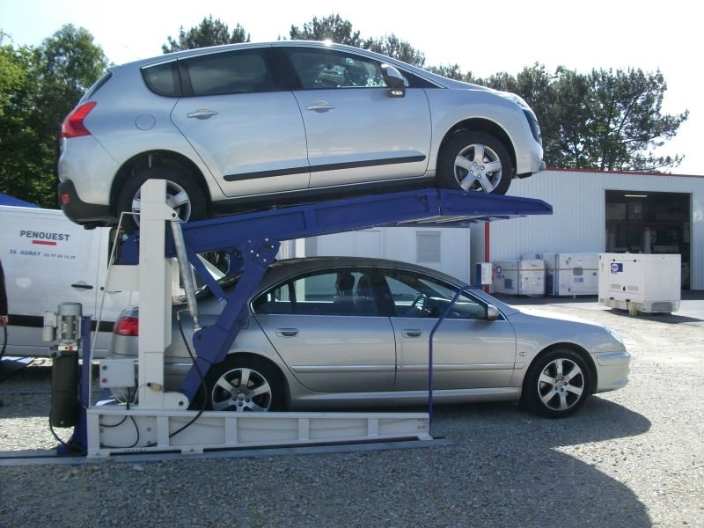
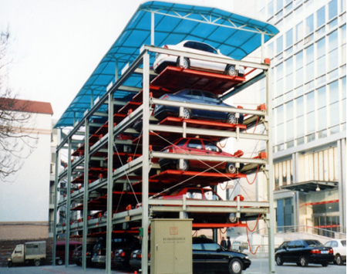
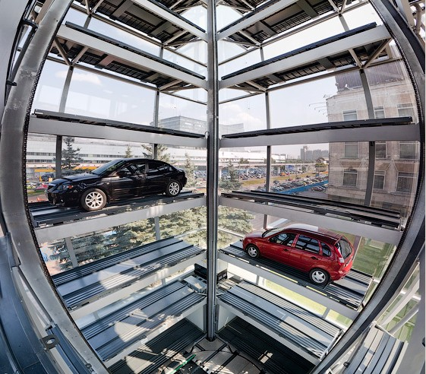
Examples

Slide 6
Implications for Future Research
Extensibility
Reusability
Cost-effectiveness
Understandability

Slide 7
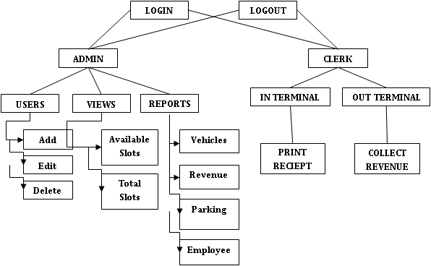
Methodology

Slide 8


Entity-Relationship Diagrams

Slide 9
Maintenance and Service
Service intervals vary for automated car parking systems, depending on the type of machines used and their usage. Parking systems should be serviced at least once a year, and up to four times a year for high traffic areas or for valet parking. In addition, regular cleaning is mandatory to keep the car parking system in good working order, especially with the problems posed by weather (salt on the road can spread to lifter platforms and cause severe damage if not removed. A reputable car parking company will regularly clean all critical elements of its automated parking system, including the car lifters top and bottom, all concrete pits, all posts resting on the concrete, and the entire concrete floor in the parking area.

